Slide 1
Employee Data Analysis using Excel
STUDENT NAME: E.Mahalakshmi
REGISTER NO: 312214902
DEPARTMENT: Bcom(CA)
COLLEGE: Annai Veilankannai’s college for women

Slide 2
PROJECT TITLE
Employee Performance Analysis using Excel

Slide 3


AGENDA
Problem Statement
Project Overview
End Users
Our Solution and Proposition
Dataset Description
Modelling Approach
Results and Discussion
Conclusion
3/21/2024 Annual Review

Slide 4

PROBLEM STATEMENT
The format of a problem statement A study's own problem statement has three main components: a synthesis or summary of the existing knowledge relevant to the research inquiry, the gaps identified by that review and why those gaps are important, and the kind of research necessary to fill those gaps.Identify the problem. Start by pointing out an issue and gathering data. ...Put the problem into context. Describe how the problem impacts customers and stakeholders. ...Find the root cause. ...Describe your ideal outcome. ...Propose a solution and outline its benefits.

Slide 5

PROJECT OVERVIEW
At their most basic level, data analytics projects involve using historical and present project data to enable efficient project delivery decisions. This includes the following: Descriptive analysis offers information in the most efficient way possible.
Data Analysis is the process of systematically applying statistical and/or logical techniques to describe and illustrate, condense and recap, and evaluate data

Slide 6

WHO ARE THE END USERS?
End users are the people who use a product or service, and are often the consumers of that product or service. They are different from the people who design, develop, or produce the product or service. Here are some things to consider about end users: User experienceIt's important to consider the end user experience when developing a product or service. This includes the user interface, which should be intuitive and easy to use. FeedbackEnd users can provide feedback on how a product or service can be improved to better meet their needs. Cross-platform accessibilityEnd users interact with a variety of devices and platforms, so it's important to ensure that the product or service is accessible on all of them. DemographicsA company can create a profile of its target end users, including their demographics, needs, goals, and user behaviors

Slide 7

OUR SOLUTION AND ITS VALUE PROPOSITION
Here are some things to consider about end users: User experienceIt's important to consider the end user experience when developing a product or service. This includes the user interface, which should be intuitive and easy to use. FeedbackEnd users can provide feedback on how a product or service can be improved to better meet their needs. Cross-platform accessibilityEnd users interact with a variety of devices and platforms, so it's important to ensure that the product or service is accessible on all of them. DemographicsA company can create a profile of its target end users, including their demographics, needs, goals, and user behaviors.Data analytics is a powerful tool that can help you create a compelling value proposition for your customers. A value proposition is a statement that explains how your product or service solves problems, provides benefits, and differentiates you from competitors. Here are some ways that data analytics can strengthen your value proposition: Identify customer needs: Data analytics can help you identify customer needs and pain points. Validate assumptions: Data analytics can help you validate your assumptions and hypotheses.

Slide 8
Dataset Description
A dataset is a structured collection of data organized and stored together for analysis or processing. The data within a dataset is typically related in some way and taken from a single source or intended for a single project. uses measures like mean, median, mode, and standard deviation to describe the main features of a data set. Example: A company analyzes sales data to determine the monthly average sales over the past year. They calculate the mean sales figures and use charts to visualize the sales trends.

Slide 9

THE "WOW" IN OUR SOLUTION
Biased data: Using biased data can reinforce inequality. For example, a company that trained a hiring program with resumes from the previous decade, which were mostly from men, taught itself to prefer men as candidates. Confidence: It's okay to make mistakes and be wrong, and growth often comes from the lessons learned. Confidence comes from being willing to learn, not from being right every time. Certifications: Getting industry certifications can help your resume stand out.
3/21/2024 Annual Review
9

Slide 10
MODELLING
Data modelingA visual representation of an organization's data that helps analysts understand the data's structure, relationships, and storage methods. Data modeling helps analysts make sense of the data, and can help improve query performance and data consistency.
Statistical modelingA mathematical representation of the relationship between variables that helps analysts make predictions, data-driven decisions, and scientific discoveries. Statistical modeling techniques include linear regression and classification.
10

Slide 11
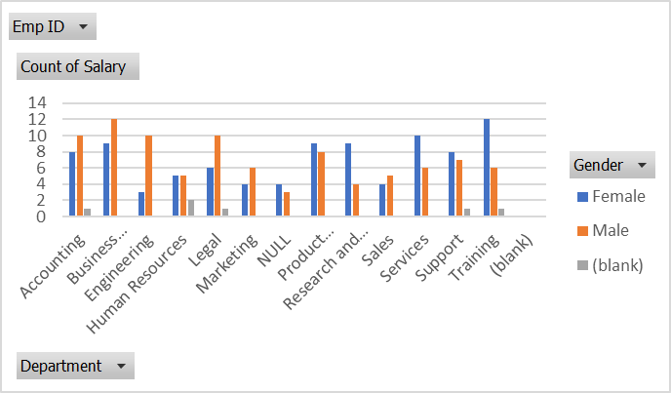
RESULTS
11

Slide 12
conclusion
Address the original question or problem Revisit the purpose of the experiment and hypothesis Evaluate the data Explain the effect of any procedural changes or experimental error Consider variables that could not be controlled for Determine the significance or importance of the data analysisConclude whether the hypotheses are confirmed or rejected Highlight key findings Make generalized comparisons Assess the strength of the claim

